Slide 1
Digital Forensics Agent System (DFAS) Student Name: Majed Alzaabi Student ID: 12698105

Slide 2

Introduction
Title: Digital Forensics Agent System (DFAS)
Subtitle: Automating evidence collection using BDI-inspired multi-agent intelligence
Student Name: Majed ALzaabi
Module: Intelligent Systems Development – Unit 11

Slide 3
Research Background & Problem Context
Increasing digital evidence volume.
Manual forensics = time-consuming.
Need for automation with integrity assurance
The BDI model as an intelligent framework

Slide 4
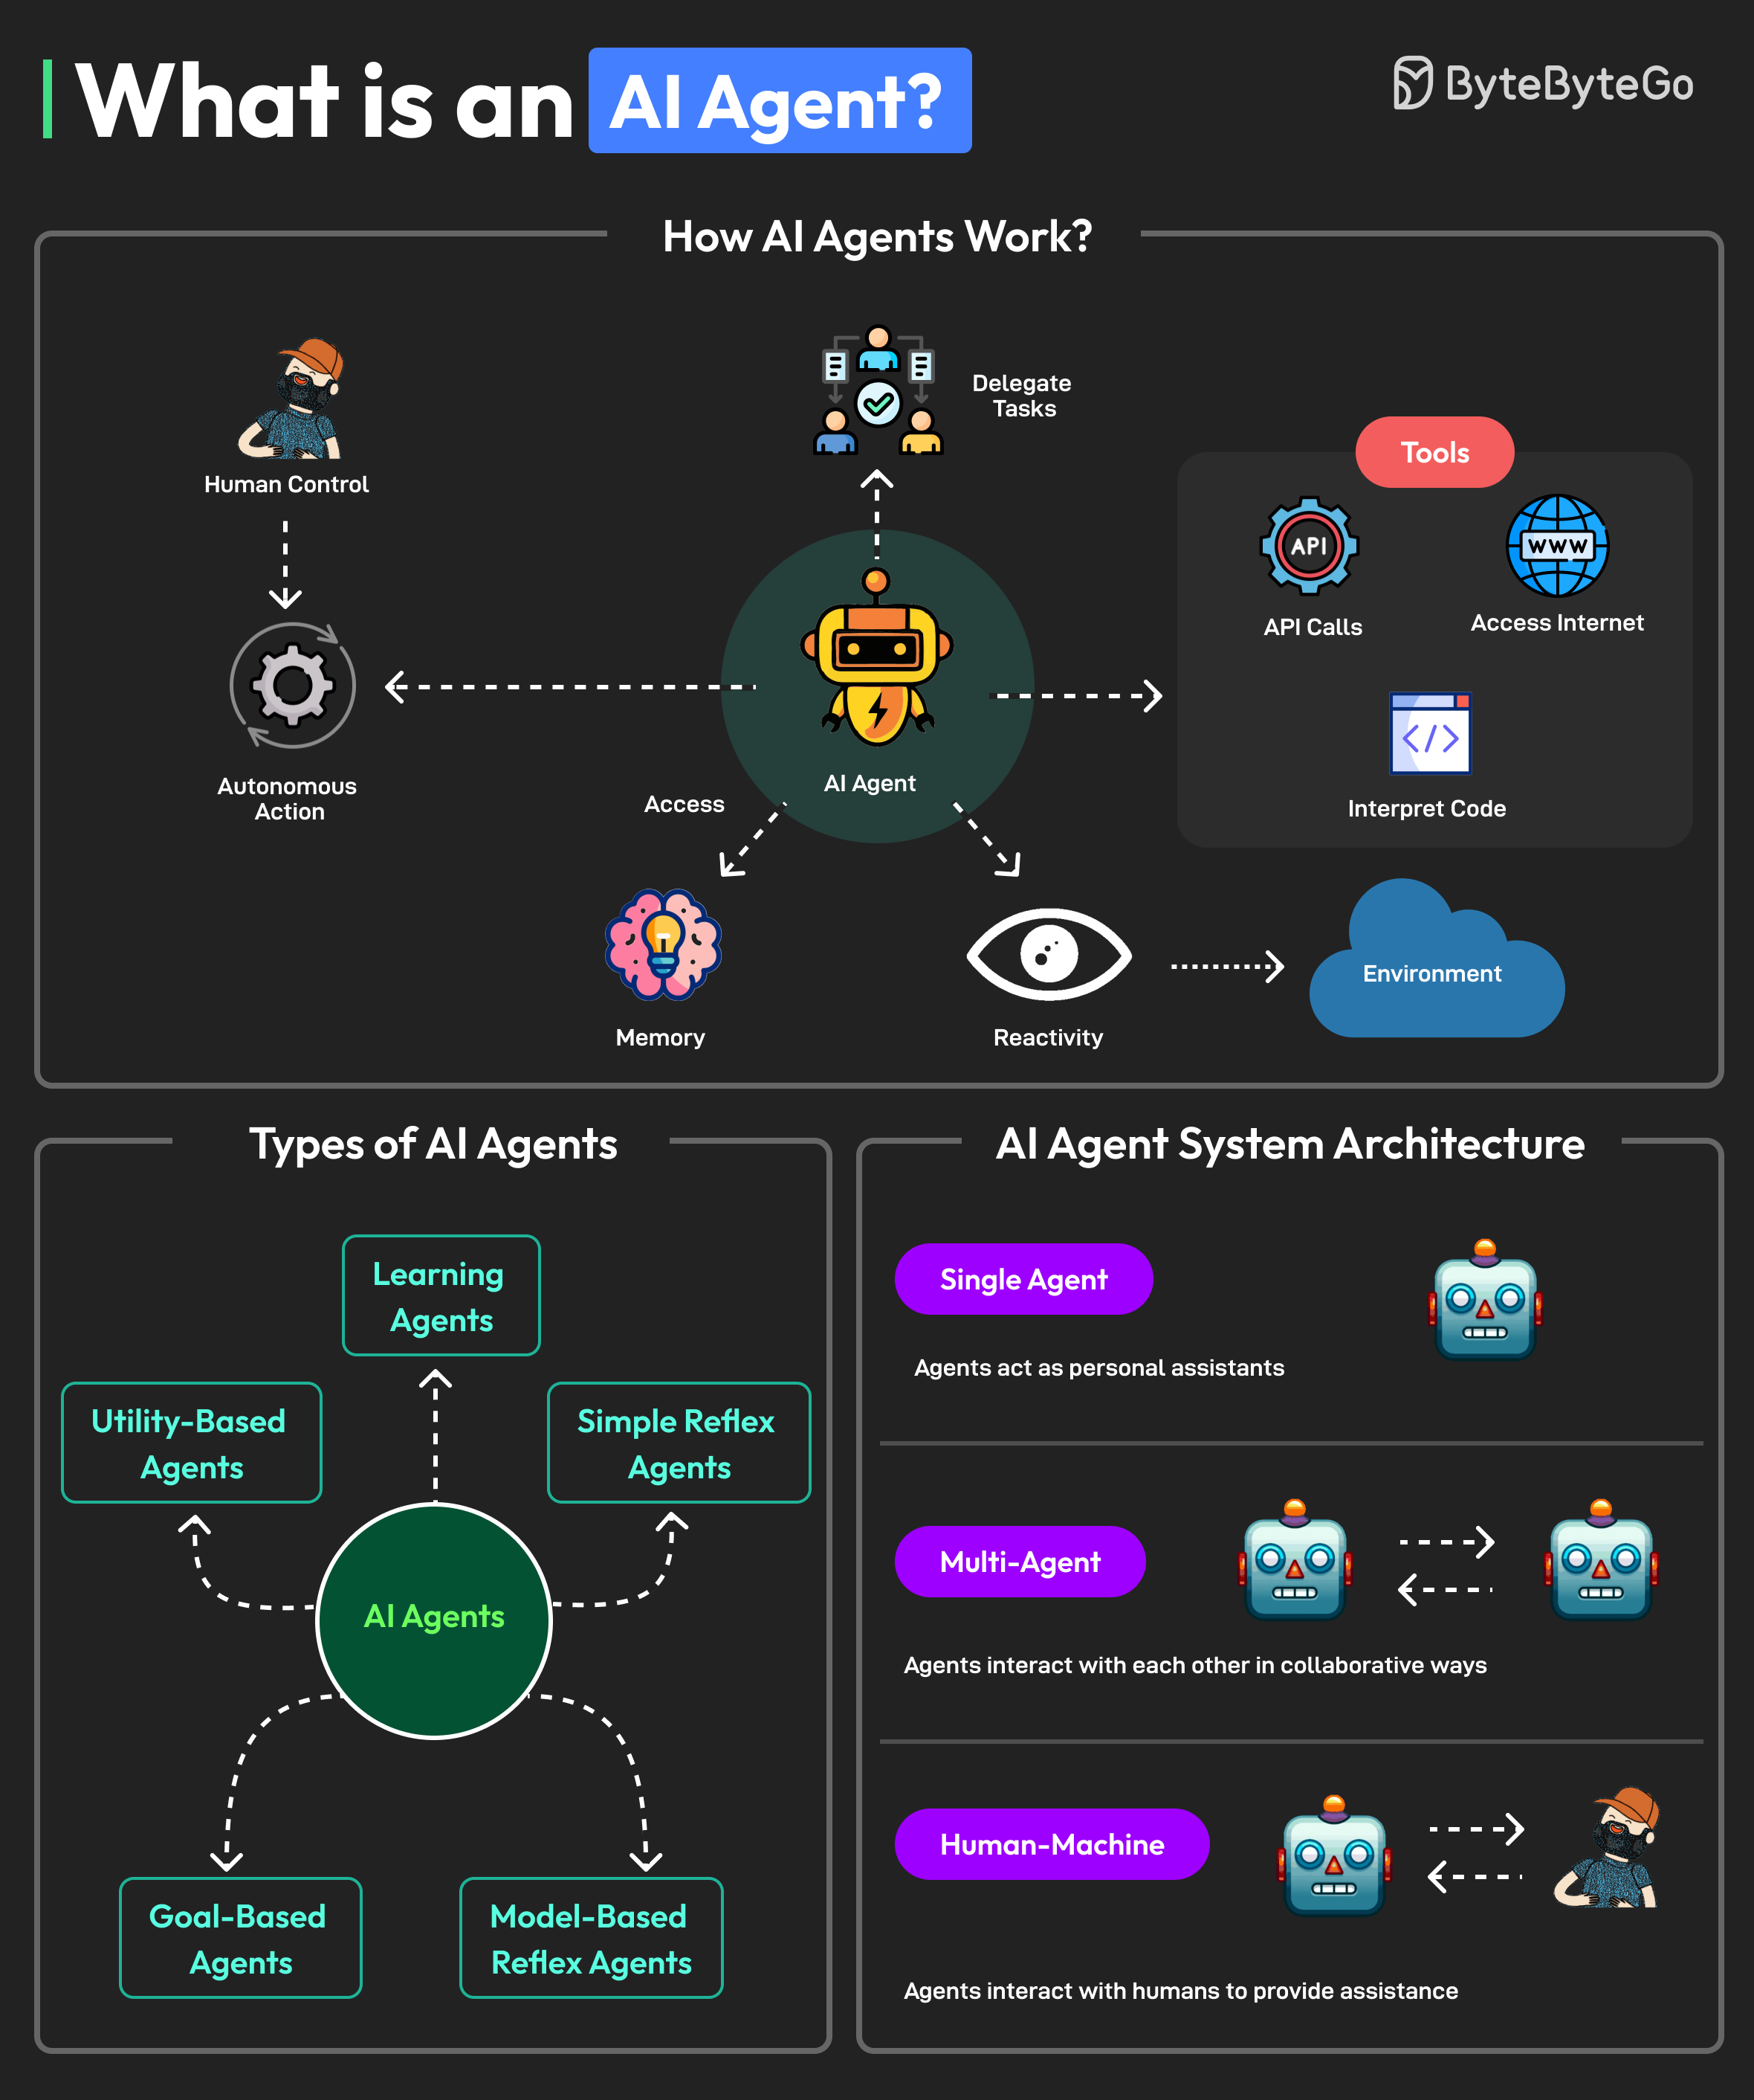
System Architecture:

Slide 5
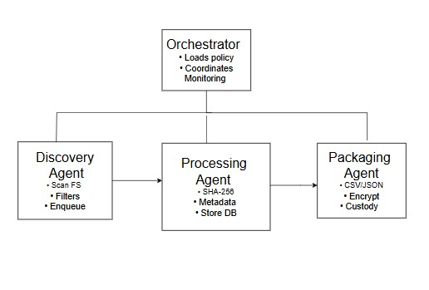
Four core agents:
Discovery Agent.
Processing Agent.
Packaging Agent.
Orchestrator Agent

Slide 6
Key Features
Automated evidence discovery.
SHA-256 integrity verification.
AES-GCM encrypted packaging.
Multi-format reports (CSV, JSON, SQLite).
Standards-based chain of custody.

Slide 7

Implementation & Design Decisions
Language: Python 3.11+.
Libraries: PyYAML, cryptography, python-magic.
Multithreading + queues
Self-documenting code with “why” comments

Slide 8
Compliance & Standards
ISO/IEC 27037 & 27043.
NIST SP 800-86.
ACPO Principles (2012).
Legal admissibility focus.

Slide 9

Testing & Validation
Unit and functional testing checklist.
Output evidence: .db, .csv, .json, .zip.
Include screenshot (3817…jpg).

Slide 10
Demonstration of Execution
Load config.
Start agents.
Process files.
Generate package.
View reports.

Slide 11
Limitations & Future Work
Add YARA-rule scanning.
Integrate GUI dashboard.
Cloud-based remote agents.
Automated chain-verification API.

Slide 12
Slide 10 — Conclusion & References
Summary of contributions
Reflection on learning outcomes
Key references:
Rao & Georgeff (1995) BDI Agents: From Theory to Practice.
Wooldridge (2009) An Introduction to MultiAgent Systems.
ISO/IEC 27037 (2012).
NIST SP 800-86 (2006)

Slide 13

Thank you
Name: Majed ALZaabi.

